Slide 1
CSE 464: Software Quality Assurance and Testing
Design Considerations of Object Oriented Applications for better Quality
Janaka Balasooriya

Slide 2
Fundamental Concepts
1. abstraction—data, interface, control
  Information hiding—controlled interfaces
  Inheritance and polymorphism
2. modularity—compartmentalization of data and function
  Functional independence—single-minded function and low coupling
3. architecture—the overall structure of the software
  patterns—”conveys the essence” of a proven design solution

Slide 3
Modularity – Lecture 1

Slide 4
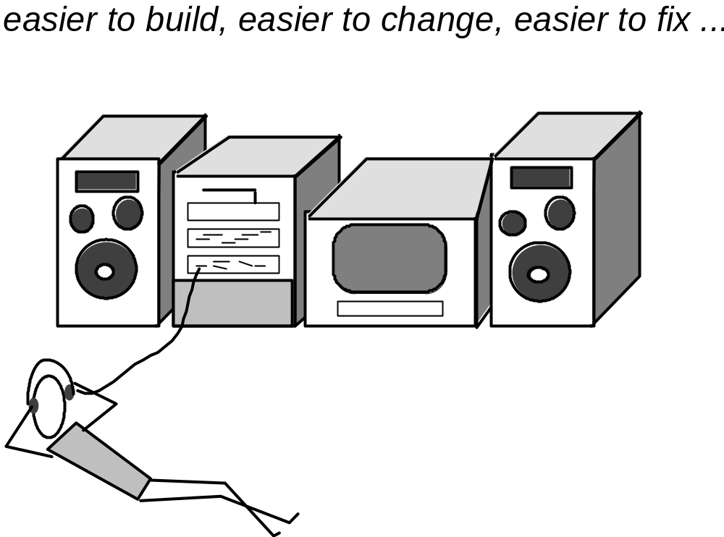
Modular Design

Slide 5
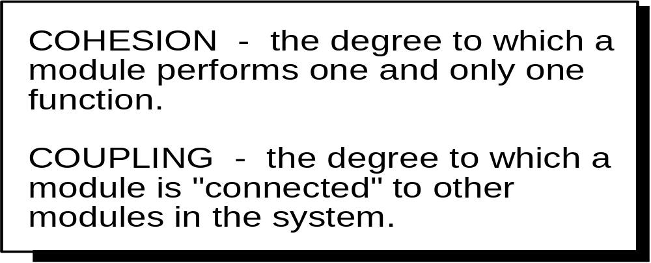
Coupling and Cohesion
A well defined object exhibits
  High cohesion
  Low coupling

Slide 6
Coupling: Degree of dependence among components (objects)
No dependencies
Loosely coupled-some dependencies
High coupling makes modifying parts of the system difficult, e.g., modifying a component affects all the components to which the component is connected.
Highly coupled-many dependencies
Reference:
Pfleeger, S., Software Engineering Theory and Practice. Prentice Hall, 2001.

Slide 7
Types of Coupling
Content Coupling: One module directly connected to the inner working of another module.
Common Coupling: Two modules share a global data item.
Control Coupling: Data in one module is used to determine the order of execution of another module.
Stamp Coupling: One module passes non-global data structures/objects to another module.
Data Coupling: One module pass elementary data types such as int, float, char as parameters to the other.

Slide 8
Coupling and Quality Impact
Data Coupling
Stamp Coupling
Control Coupling
Common Coupling
Content Coupling
Low Coupling Spectrum High

Slide 9
Cohesion
The degree to which all elements of a component are directed towards a single task and all elements directed towards that task are contained in a single component.
class compXYX
{
string x, y, z;
int p, q;
A(){ p = x.length();}
B() { q = y.length() – z.length()}
}
Lack of Cohesion

Slide 10
Coupling and Cohesion Activity

Slide 11
References
[1] Martin Fowler. Refactoring: Improving the Design of Existing Code, Addison-Wesley, 1999. ISBN 0-201-48567-2
[2] Java Solutions, 2012 Pearson Education, Inc

